Slide 1
Levenshtein Distance Parallelism with GPUs
Presented by Ha Hwang and Wasfi Momen

Slide 2
Paper Details
Published in the IEEE digital, but also at the The 7th International Conference on Information and Communication Systems (ICICS)
Authors:
Khaled Balhaf, Mohammed A. Shehab, Wala’a T. Al-Sarayrah, Mahmoud Al-Ayyoub, Mohammed Al-Saleh and Yaser Jararweh
Jordan University of Science and Technology
Notes:
Hamming and Levenshtein are connected via Information Theory

Slide 3
Background and Motivation
Distance metrics give an idea of how much work we need to do to achieve a solution or how "close" we are to a solution.
Various types of distance metrics. EMD/Wasserstein, Acoustic, Hamming, Manhattan.
Can be modeled as optimization problems to iteratively reduce cost
Wide variety of applications
Spelling Correction, No-Fly List Tracking, Search Engine
Cryptography, Privacy
DNA sequencing
Notes:
Hamming, Gray, and Levenshtein are all connected by Information Theory

Slide 4
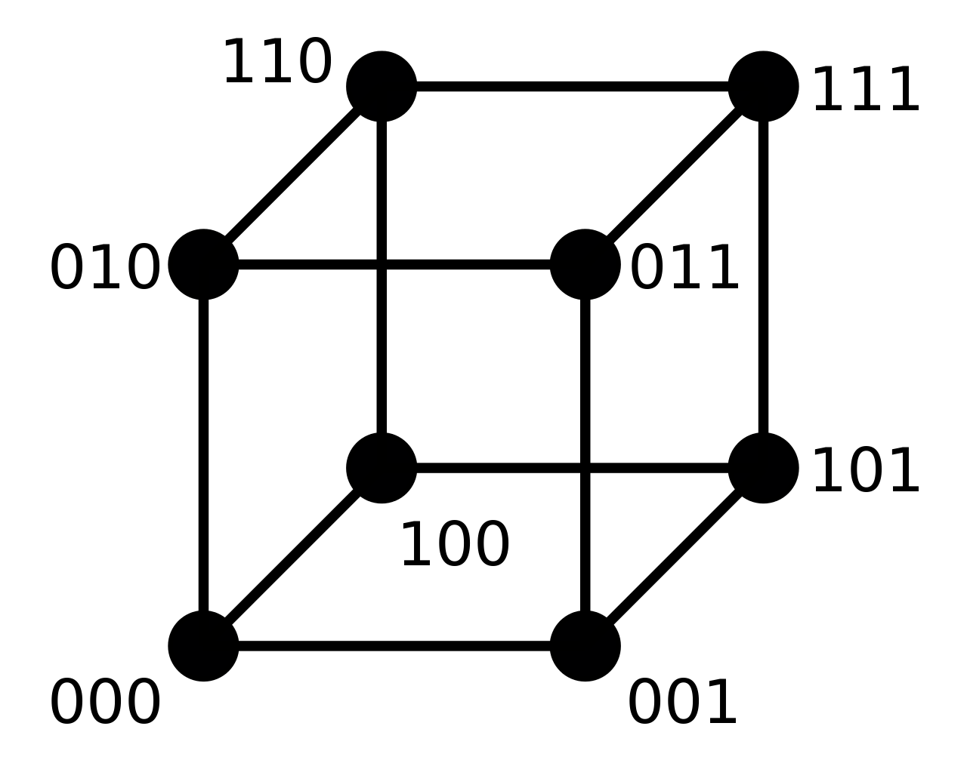
Explanation of Problem: Hamming Distance
Remember Hamming Distance?
Useful for finding the distance of equivalent length strings
Actually may outperform Levenshtein Distance on large strings since Hamming Distance is the upper bound of Levenshtein Distance in the case of same length strings.
May outperform Gray (single-distance) codes in some situations.
Hamming Distance is useful for finding substitutions.
Can correct one-bit errors and detect (but not fix) two-bit errors.
Notes:
If we flip the same bit it doesn't seem like an error. If we flip two bits, we aren't sure which is the flipped bit.
Source on outperform Gray: https://www.umsl.edu/mathcs/about/People/Faculty/CezaryJanikow/untitled%20folder/An%20Alalysis.pdf

Slide 5
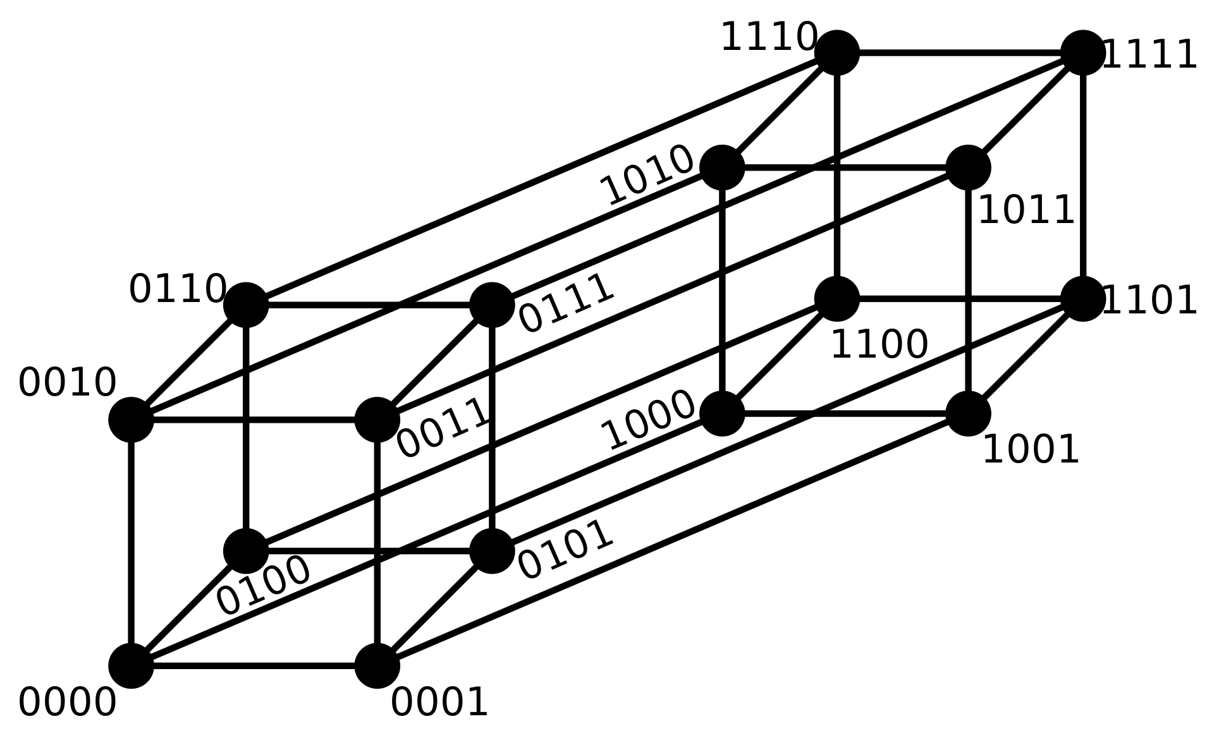
Be Careful Who You Call Ugly In Middle School
Notes:
Hypercube of Hamming Distance for 4 bits.
Due to symmetry and triangle inequality, we need to reflect every vertex. (Show 2's complement as example)
Still doesn't fix 2 error bit codes, Similar to DNA ATCG, but then we can't decide which errors to fix.

Slide 6
Explanation of Problem: Levenshtein Distance
Levenshtein allows for insertion, deletion, and substitution.
Levenshtein distance is better understood as the alignment of two strings. We try to find the minimum number of insertion, deletion, and substitution of characters in order to change string s to string t.
Specific algorithms like Smith-Waterman or Needle-Munsch generalize Levenshtein and have properties that can be exploited to give better constraints
Notes:
Hamming and Levenshtein are connected via Information Theor

Slide 7
Explanation of Problem: Levenshtein Distance
Which performs better Hamming or Levenshtein?
"01234":"12340"
"11234":"11324"
"flaw":"lawn"
Notes:
01234 to 12340: Hamming requires 1+1+1+1+1 = 5 substitutions, Levenshtein requires 2, insert 0 the beginning and delete 0 in end.
11234 to 11324: Hamming requires 2 substitutions, Levenshtein requires 2 insertions and deletions.
flaw to lawn: Hamming requires substitution of all letters, distance of 4, while Levenshtein we delete f and insert n at the end, distance of 2.

Slide 8
Explanation of Problem: Levenshtein Distance
Which performs better Hamming or Levenshtein?
"01234":"12340"
"11234":"11324"
"flaw":"lawn"
Answers:
01234 to 12340: Hamming requires 1+1+1+1+1 = 5 substitutions, Levenshtein requires 2, insert 0 the beginning and delete 0 in end.
11234 to 11324: Hamming requires 2 substitutions, Levenshtein requires 2 insertions and deletions. Represents the upper bound of Levenshtein.
flaw to lawn: Hamming requires substitution of all letters, distance of 4, while Levenshtein we delete f and insert n at the end, distance of 2.
Notes:
01234 to 12340: Hamming requires 1+1+1+1+1 = 5 substitutions, Levenshtein requires 2, insert 0 the beginning and delete 0 in end. Represents case of Hamming distance being outperformed.
11234 to 11324: Hamming requires 2 substitutions, Levenshtein requires 2 insertions and deletions.
flaw to lawn: Hamming requires substitution of all letters, distance of 4, while Levenshtein we delete f and insert n at the end, distance of 2.

Slide 9
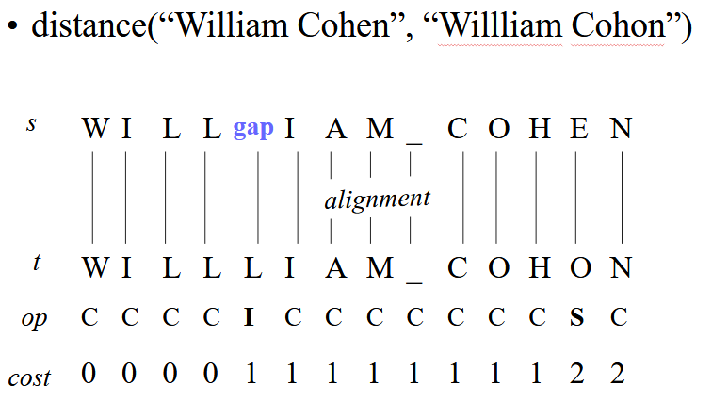
Explanation of Problem: Levenshtein Distance
Notes:
Source: Distance functions and IE William W. Cohen CALD. Announcements March 25 Thus – talk from Carlos Guestrin (Assistant Prof in Cald as of fall 2004) on max-margin.

Slide 10
Explanation of Problem: Levenshtein Distance
We can model Levenshtein in n x m matrix with one row representing string s and one column representing string t.
Explicitly, for each cell,
If the string is the same, the distance is 0. Otherwise, the distance is 1. Store this value, named score.
Get the value of the upper cell, the left cell, and the upper left cell.
Find the minimum of the following:
(Substitution) Add score to the upper left cell.
(Insertion) Add 1 to the upper cell.
(Deletion) Add 1 to the left cell.
Store the minimum in the cell.
By the end of transversal of the string, cell (n, m) will contain the Levenshtein Distance.
Notes:
Source: Distance functions and IE William W. Cohen CALD. Announcements March 25 Thus – talk from Carlos Guestrin (Assistant Prof in Cald as of fall 2004) on max-margin.

Slide 11
Explanation of Problem: Levenshtein Distance
Problem Space Guarantees:
One mistake (insertion, deletion, substitution) can guarantee 80% coverage of errors in English corpus ala Damerau-Levenshtein Distance.
Proven that Levenshtein has problem (21 Karp) and cannot improve on strings larger than n^{2-e} some e constant. Subquadratic space too large to guarantee less than subexponential time.
Notes:
Source on Damerau: https://dl.acm.org/citation.cfm?id=363994
Source on 3-SAT, or Orthogonal Vectors Problem, impossibility: https://arxiv.org/abs/1412.0348

Slide 12
Initialization: Sequential Levenshtein Distance
G | T | A | G | C
 | G | T | A | G | C
A
T
A
C
C
A | T | A | C | C
1 | 0 | 0 | 1 | 0
Notes:
Source: Distance functions and IE William W. Cohen CALD. Announcements March 25 Thus – talk from Carlos Guestrin (Assistant Prof in Cald as of fall 2004) on max-margin.

Slide 13
Initialization: Sequential Levenshtein Distance
G | T | A | G | C
 | G | T | A | G | C
A | 1 | 0 | 0 | 1 | 0
T
A
C
C
A | T | A | C | C
1 | 0 | 0 | 1 | 0
Notes:
Source: Distance functions and IE William W. Cohen CALD. Announcements March 25 Thus – talk from Carlos Guestrin (Assistant Prof in Cald as of fall 2004) on max-margin.

Slide 14
Initialization: Sequential Levenshtein Distance
G | T | A | G | C
 | G | T | A | G | C
A | 1 | 0 | 0 | 1 | 0
T | 1 | 0 | 0 | 1 | 0
A | 1 | 0 | 0 | 1 | 0
C | 1 | 0 | 0 | 1 | 0
C | 1 | 0 | 0 | 1 | 0
A | T | A | C | C
1 | 0 | 0 | 1 | 0
Notes:
Source: Distance functions and IE William W. Cohen CALD. Announcements March 25 Thus – talk from Carlos Guestrin (Assistant Prof in Cald as of fall 2004) on max-margin.

Slide 15
Sequential Levenshtein Distance
For each cell,
If the string is the same, the distance is 0. O/w the distance is 1. Store this value, named score.
Get the value of the upper cell, the left cell, and the upper left cell.
Find the minimum of the following:
(Substitution) Add score to the upper left cell.
(Insertion) Add 1 to the upper cell.
(Deletion) Add 1 to the left cell.
Store the minimum in the cell.
By the end of transversal of the string, cell(n, m) will contain the Levenshtein Distance.
 | G | T | A | G | C
A | 1+1 | 0+1 | 0 | 1 | 0
T | 1+1 | 1 | 0 | 1 | 0
A | 1 | 0 | 0 | 1 | 0
C | 1 | 0 | 0 | 1 | 0
C | 1 | 0 | 0 | 1 | 0
Notes:
Source: Distance functions and IE William W. Cohen CALD. Announcements March 25 Thus – talk from Carlos Guestrin (Assistant Prof in Cald as of fall 2004) on max-margin.

Slide 16
Sequential Levenshtein Distance
For each cell,
If the string is the same, the distance is 0. O/w the distance is 1. Store this value, named score.
Get the value of the upper cell, the left cell, and the upper left cell.
Find the minimum of the following:
(Substitution) Add score to the upper left cell.
(Insertion) Add 1 to the upper cell.
(Deletion) Add 1 to the left cell.
Store the minimum in the cell.
By the end of transversal of the string, cell(n, m) will contain the Levenshtein Distance.
 | G | T | A | G | C
A | 1 | 0+0 | 0+1 | 1 | 0
T | 1 | 1+1 | 0 | 1 | 0
A | 1 | 0 | 0 | 1 | 0
C | 1 | 0 | 0 | 1 | 0
C | 1 | 0 | 0 | 1 | 0
Notes:
Source: Distance functions and IE William W. Cohen CALD. Announcements March 25 Thus – talk from Carlos Guestrin (Assistant Prof in Cald as of fall 2004) on max-margin.

Slide 17
Sequential Levenshtein Distance
For each cell,
If the string is the same, the distance is 0. O/w the distance is 1. Store this value, named score.
Get the value of the upper cell, the left cell, and the upper left cell.
Find the minimum of the following:
(Substitution) Add score to the upper left cell.
(Insertion) Add 1 to the upper cell.
(Deletion) Add 1 to the left cell.
Store the minimum in the cell.
By the end of transversal of the string, cell(n, m) will contain the Levenshtein Distance.
 | G | T | A | G | C
A | 1 | 0 | 0+0 | 1+1 | 0
T | 1 | 1 | 0+1 | 0 | 0
A | 1 | 0 | 0 | 1 | 0
C | 1 | 0 | 0 | 1 | 0
C | 1 | 0 | 0 | 1 | 0
Notes:
Source: Distance functions and IE William W. Cohen CALD. Announcements March 25 Thus – talk from Carlos Guestrin (Assistant Prof in Cald as of fall 2004) on max-margin.

Slide 18
Sequential Levenshtein Distance
For each cell,
If the string is the same, the distance is 0. O/w the distance is 1. Store this value, named score.
Get the value of the upper cell, the left cell, and the upper left cell.
Find the minimum of the following:
(Substitution) Add score to the upper left cell.
(Insertion) Add 1 to the upper cell.
(Deletion) Add 1 to the left cell.
Store the minimum in the cell.
By the end of transversal of the string, cell(n, m) will contain the Levenshtein Distance.
 | G | T | A | G | C
A | 1 | 0 | 0 | 1+1 | 0+1
T | 1 | 1 | 0 | 0+1 | 1
A | 1 | 0 | 0 | 1 | 0
C | 1 | 0 | 0 | 1 | 0
C | 1 | 0 | 0 | 1 | 0
Notes:
Source: Distance functions and IE William W. Cohen CALD. Announcements March 25 Thus – talk from Carlos Guestrin (Assistant Prof in Cald as of fall 2004) on max-margin.

Slide 19
Sequential Levenshtein Distance
For each cell,
If the string is the same, the distance is 0. O/w the distance is 1. Store this value, named score.
Get the value of the upper cell, the left cell, and the upper left cell.
Find the minimum of the following:
(Substitution) Add score to the upper left cell.
(Insertion) Add 1 to the upper cell.
(Deletion) Add 1 to the left cell.
Store the minimum in the cell.
By the end of transversal of the string, cell(n, m) will contain the Levenshtein Distance.
 | G | T | A | G | C
A | 1 | 0 | 0 | 1 | 0
T | 1+1 | 1+1 | 0 | 0 | 1
A | 1+1 | 2 | 0 | 1 | 0
C | 1 | 0 | 0 | 1 | 0
C | 1 | 0 | 0 | 1 | 0
Notes:
Source: Distance functions and IE William W. Cohen CALD. Announcements March 25 Thus – talk from Carlos Guestrin (Assistant Prof in Cald as of fall 2004) on max-margin.

Slide 20
Sequential Levenshtein Distance
For each cell,
If the string is the same, the distance is 0. O/w the distance is 1. Store this value, named score.
Get the value of the upper cell, the left cell, and the upper left cell.
Find the minimum of the following:
(Substitution) Add score to the upper left cell.
(Insertion) Add 1 to the upper cell.
(Deletion) Add 1 to the left cell.
Store the minimum in the cell.
By the end of transversal of the string, cell(n, m) will contain the Levenshtein Distance.
 | G | T | A | G | C
A | 1 | 0 | 0 | 1 | 0
T | 1 | 1+0 | 0+1 | 0 | 1
A | 1 | 2+1 | 1 | 1 | 0
C | 1 | 0 | 0 | 1 | 0
C | 1 | 0 | 0 | 1 | 0
Notes:
Source: Distance functions and IE William W. Cohen CALD. Announcements March 25 Thus – talk from Carlos Guestrin (Assistant Prof in Cald as of fall 2004) on max-margin.

Slide 21
Sequential Levenshtein Distance
For each cell,
If the string is the same, the distance is 0. O/w the distance is 1. Store this value, named score.
Get the value of the upper cell, the left cell, and the upper left cell.
Find the minimum of the following:
(Substitution) Add score to the upper left cell.
(Insertion) Add 1 to the upper cell.
(Deletion) Add 1 to the left cell.
Store the minimum in the cell.
By the end of transversal of the string, cell(n, m) will contain the Levenshtein Distance.
 | G | T | A | G | C
A | 1 | 0 | 0 | 1 | 0
T | 1 | 1 | 0+0 | 0+1 | 1
A | 1 | 2 | 1+1 | 0 | 0
C | 1 | 0 | 0 | 1 | 0
C | 1 | 0 | 0 | 1 | 0
Notes:
Source: Distance functions and IE William W. Cohen CALD. Announcements March 25 Thus – talk from Carlos Guestrin (Assistant Prof in Cald as of fall 2004) on max-margin.

Slide 22
Sequential Levenshtein Distance
For each cell,
If the string is the same, the distance is 0. O/w the distance is 1. Store this value, named score.
Get the value of the upper cell, the left cell, and the upper left cell.
Find the minimum of the following:
(Substitution) Add score to the upper left cell.
(Insertion) Add 1 to the upper cell.
(Deletion) Add 1 to the left cell.
Store the minimum in the cell.
By the end of transversal of the string, cell(n, m) will contain the Levenshtein Distance.
 | G | T | A | G | C
A | 1 | 0 | 0 | 1 | 0
T | 1 | 1 | 0 | 0+1 | 1+1
A | 1 | 2 | 0 | 0+1 | 1
C | 1 | 0 | 0 | 1 | 0
C | 1 | 0 | 0 | 1 | 0
Notes:
Source: Distance functions and IE William W. Cohen CALD. Announcements March 25 Thus – talk from Carlos Guestrin (Assistant Prof in Cald as of fall 2004) on max-margin.

Slide 23
Work-Time Analysis
For sequential algorithm
T(n) = O(n^2) depth of calculation goes through 2D loop
W(n) = O(n^2) length of calculation also is 2D loop
Reducing dependence of upper left, upper, left cells is the key to parallelizing Levenshtein algorithm

Slide 24
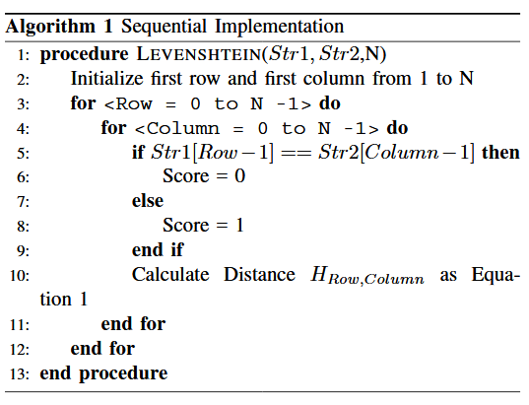
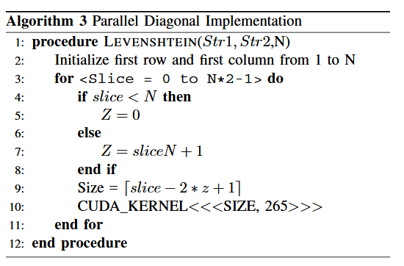
Sequential and Parallel Algorithms
Notes:
Temp

Slide 25
Diagonal Levenshtein Distance
Next diagonal depends on previous diagonal
max(row, col) * 2 -1 gives total number of diagonal slices
Upper left half has value in 0th row
Bottom right half has value in +1th row
 | G | T | A | G | C
A
T
A
C
C
Notes:
Source: Distance functions and IE William W. Cohen CALD. Announcements March 25 Thus – talk from Carlos Guestrin (Assistant Prof in Cald as of fall 2004) on max-margin.

Slide 26
Diagonal Levenshtein Distance
Next diagonal depends on previous diagonal
max(row, col) * 2 -1 gives total number of diagonal slices
Upper left half has value in 0th row
Bottom right half has value in +1th row
For 0 to 0
 | G | T | A | G | C
A | 1
T
A
C
C
Notes:
Source: Distance functions and IE William W. Cohen CALD. Announcements March 25 Thus – talk from Carlos Guestrin (Assistant Prof in Cald as of fall 2004) on max-margin.

Slide 27
Diagonal Levenshtein Distance
Next diagonal depends on previous diagonal
max(row, col) * 2 -1 gives total number of diagonal slices
Upper left half has value in 0th row
Bottom right half has value in +1th row
For 0 to 1
 | G | T | A | G | C
A | 1 | 1
T | 1
A
C
C
Notes:
Source: Distance functions and IE William W. Cohen CALD. Announcements March 25 Thus – talk from Carlos Guestrin (Assistant Prof in Cald as of fall 2004) on max-margin.

Slide 28
Diagonal Levenshtein Distance
Next diagonal depends on previous diagonal
max(row, col) * 2 -1 gives total number of diagonal slices
Upper left half has value in 0th row
Bottom right half has value in +1th row
For 0 to 2
 | G | T | A | G | C
A | 1 | 1 | 0
T | 1 | 0
A | 1
C
C
Notes:
Source: Distance functions and IE William W. Cohen CALD. Announcements March 25 Thus – talk from Carlos Guestrin (Assistant Prof in Cald as of fall 2004) on max-margin.

Slide 29
Diagonal Levenshtein Distance
Next diagonal depends on previous diagonal
max(row, col) * 2 -1 gives total number of diagonal slices
Upper left half has value in 0th row
Bottom right half has value in +1th row
For 0 to 3
 | G | T | A | G | C
A | 1 | 1 | 0 | 1
T | 1 | 0 | 1
A | 1 | 1
C | 1
C
Notes:
Source: Distance functions and IE William W. Cohen CALD. Announcements March 25 Thus – talk from Carlos Guestrin (Assistant Prof in Cald as of fall 2004) on max-margin.

Slide 30
Diagonal Levenshtein Distance
Next diagonal depends on previous diagonal
max(row, col) * 2 -1 gives total number of diagonal slices
Upper left half has value in 0th row
Bottom right half has value in +1th row
For 0 to 4
 | G | T | A | G | C
A | 1 | 1 | 0 | 1 | 1
T | 1 | 0 | 1 | 1
A | 1 | 1 | 0
C | 1 | 1
C | 1
Notes:
Source: Distance functions and IE William W. Cohen CALD. Announcements March 25 Thus – talk from Carlos Guestrin (Assistant Prof in Cald as of fall 2004) on max-margin.

Slide 31
Diagonal Levenshtein Distance
Next diagonal depends on previous diagonal
max(row, col) * 2 -1 gives total number of diagonal slices
Upper left half has value in 0th row
Bottom right half has value in +1th row
For 1 to 5
 | G | T | A | G | C
A | 1 | 1 | 0 | 1 | 1
T | 1 | 0 | 1 | 1 | 1
A | 1 | 1 | 0 | 1
C | 1 | 1 | 1
C | 1 | 1
Notes:
Source: Distance functions and IE William W. Cohen CALD. Announcements March 25 Thus – talk from Carlos Guestrin (Assistant Prof in Cald as of fall 2004) on max-margin.

Slide 32
Diagonal Levenshtein Distance
Next diagonal depends on previous diagonal
max(row, col) * 2 -1 gives total number of diagonal slices
Upper left half has value in 0th row
Bottom right half has value in +1th row
For 2 to 6
 | G | T | A | G | C
A | 1 | 1 | 0 | 1 | 1
T | 1 | 0 | 1 | 1 | 1
A | 1 | 1 | 0 | 1 | 1
C | 1 | 1 | 1 | 1
C | 1 | 1 | 1
Notes:
Source: Distance functions and IE William W. Cohen CALD. Announcements March 25 Thus – talk from Carlos Guestrin (Assistant Prof in Cald as of fall 2004) on max-margin.

Slide 33
Diagonal Levenshtein Distance
Next diagonal depends on previous diagonal
max(row, col) * 2 -1 gives total number of diagonal slices
Upper left half has value in 0th row
Bottom right half has value in +1th row
For 3 to 7
 | G | T | A | G | C
A | 1 | 1 | 0 | 1 | 1
T | 1 | 0 | 1 | 1 | 1
A | 1 | 1 | 0 | 1 | 1
C | 1 | 1 | 1 | 1 | 0
C | 1 | 1 | 1 | 1
Notes:
Source: Distance functions and IE William W. Cohen CALD. Announcements March 25 Thus – talk from Carlos Guestrin (Assistant Prof in Cald as of fall 2004) on max-margin.

Slide 34
Diagonal Levenshtein Distance
Next diagonal depends on previous diagonal
max(row, col) * 2 -1 gives total number of diagonal slices
Upper left half has value in 0th row
Bottom right half has value in +1th row
For 4 to 8
 | G | T | A | G | C
A | 1 | 1 | 0 | 1 | 1
T | 1 | 0 | 1 | 1 | 1
A | 1 | 1 | 0 | 1 | 1
C | 1 | 1 | 1 | 1 | 0
C | 1 | 1 | 1 | 1 | 0
Notes:
Source: Distance functions and IE William W. Cohen CALD. Announcements March 25 Thus – talk from Carlos Guestrin (Assistant Prof in Cald as of fall 2004) on max-margin.

Slide 35
Diagonal Levenshtein Distance
Next diagonal depends on previous diagonal
max(row, col) * 2 -1 gives total number of diagonal slices
Upper left half has value in 0th row
Bottom right half has value in +1th row
Calculate minimum of upper left, upper, left cells
 | G | T | A | G | C
A | 1+1 | 1+1 | 0 | 1 | 1
T | 1+1 | 2 | 1 | 1 | 1
A | 1 | 1 | 0 | 1 | 1
C | 1 | 1 | 1 | 1 | 0
C | 1 | 1 | 1 | 1 | 0
Notes:
Source: Distance functions and IE William W. Cohen CALD. Announcements March 25 Thus – talk from Carlos Guestrin (Assistant Prof in Cald as of fall 2004) on max-margin.

Slide 36
Diagonal Levenshtein Distance
Next diagonal depends on previous diagonal
max(row, col) * 2 -1 gives total number of diagonal slices
Upper left half has value in 0th row
Bottom right half has value in +1th row
Notice that the entire diagonal can be calculated
For this step, 2 threads can run in parallel
 | G | T | A | G | C
A | 1 | 1+0 | 0+1 | 1 | 1
T | 1+0 | 2+1 | 1 | 1 | 1
A | 1+1 | 1 | 0 | 1 | 1
C | 1 | 1 | 1 | 1 | 0
C | 1 | 1 | 1 | 1 | 0
Notes:
Source: Distance functions and IE William W. Cohen CALD. Announcements March 25 Thus – talk from Carlos Guestrin (Assistant Prof in Cald as of fall 2004) on max-margin.

Slide 37
Diagonal Levenshtein Distance
Next diagonal depends on previous diagonal
max(row, col) * 2 -1 gives total number of diagonal slices
Upper left half has value in 0th row
Bottom right half has value in +1th row
Notice that the entire diagonal can be calculated
For this step, 2 threads can run in parallel
And next step, 3 threads
 | G | T | A | G | C
A | 1 | 1+0 | 0+1 | 1 | 1
T | 1+0 | 2+1 | 1 | 1 | 1
A | 1+1 | 1 | 0 | 1 | 1
C | 1 | 1 | 1 | 1 | 0
C | 1 | 1 | 1 | 1 | 0
Notes:
Source: Distance functions and IE William W. Cohen CALD. Announcements March 25 Thus – talk from Carlos Guestrin (Assistant Prof in Cald as of fall 2004) on max-margin.

Slide 38
Work-Time Analysis (Parallel)
For sequential algorithm
T(n) is between O(n) and O(n^2) depth of calculation is not halved, but depth is reduced
W(n) is between O(n) and O(n^2)
It is weakly optimal algorithm

Slide 39
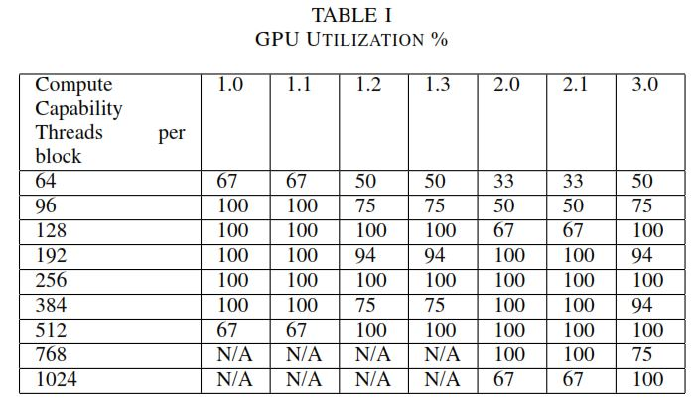
Results
Number of threads : 256
Based on GPU utilization test
Due to hardware limitation, 2D array converted into 1D arrays
GPU converts index back to 2D
Notes:
Software: Windows 10 as operating system, MicrosoftVisual Studio 2013, CUDA toolkit V7.5 and NVIDIA drivers.
Hardware: GPU (GT 740M NVIDIA) 2GB memory, IntelCPU I7 with 6GB RAM and memory bandwidth 14.40GB/s.

Slide 40
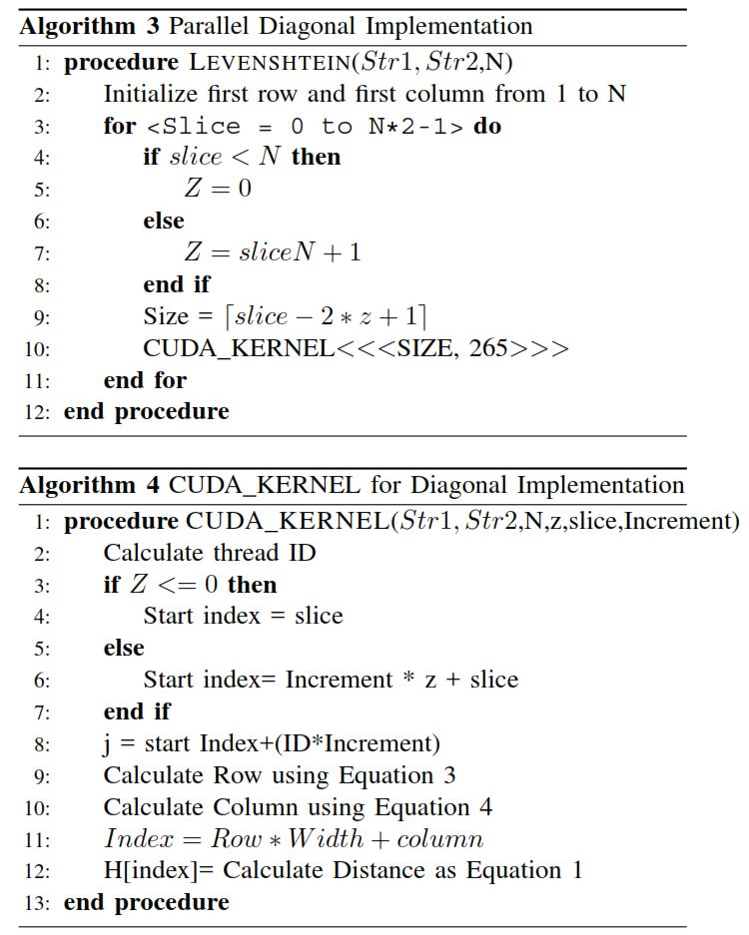
Results
// Filled equations procedure CUDA_KERNEL(Str1, Str2, N, z, slice, Increment)
Calculate threadID
if Z <= 0 then
start_index = slice //started from beginning
else
start_index = Increment * z + slice //progressing through array slices
end if
j = start_index + (threadID * Increment)
Row = start_index / Width //Width is blockDim.x
Column = Index % Width
Index = Row * Width + Column // i = blockIdx.x * blockDim.x + threadIdx.x
H[Index] = take the min of the 3 cells (Levenshtein)
end procedure
Number of threads : 256
Based on GPU utilization test
GT 740M, Kepler
Depends on CPU used
Due to hardware limitation, 2D array converted into 1D arrays
Index

Slide 41
Conclusion and Future Work
CPU implementation (sequential) of Levenshtein algorithm takes longer time as input sequence size increases
GPU implementation (parallel) shows 11x speed improvement when input sequence size reaches about 6000
Diagonal Levenshtein algorithm solves some dependence between matrix cells
It would have been useful to include power consumption, heat generation, and noise comparing CPU (sequential) and GPU (parallel).
Also, modern CPU with octa-cores or more can be tested in both sequential and parallel modes. It was not clear if authors used only one CPU thread or multiple threads.
Notes:
Software: Windows 10 as operating system, MicrosoftVisual Studio 2013, CUDA toolkit V7.5 and NVIDIA drivers.

